Slide 1
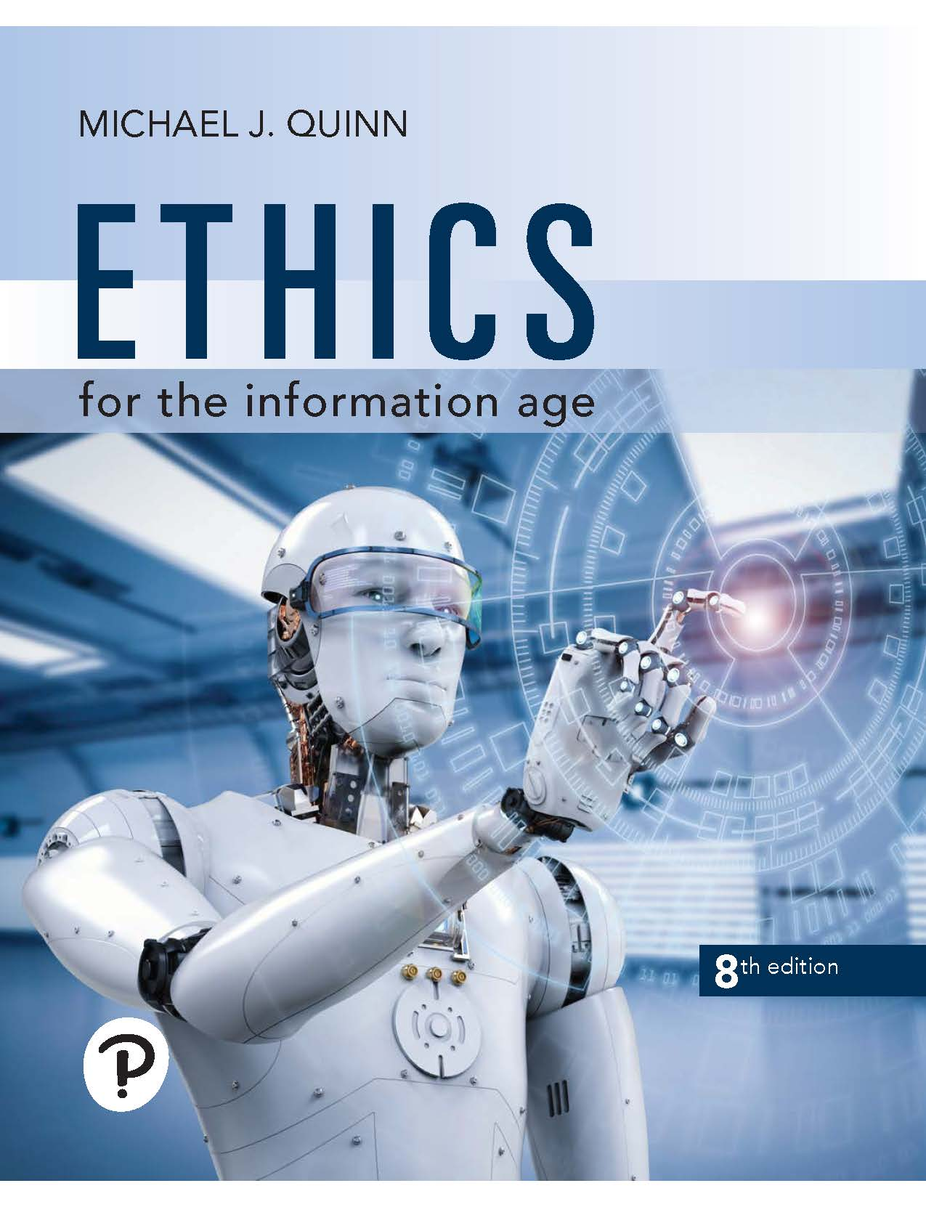
Ethics for the Information Age
Eighth Edition
Chapter 2
Introduction to Ethics
Copyright © 2020, 2017, 2015 Pearson Education, Inc. All Rights Reserved
Notes:
If this PowerPoint presentation contains mathematical equations, you may need to check that your computer has the following installed:
1) MathType Plugin
2) Math Player (free versions available)
3) NVDA Reader (free versions available)

Slide 2
Learning Objectives (1 of 2)
2.1 Introduction
2.2 Subjective relativism
2.3 Cultural relativism
2.4 Divine command theory
2.5 Ethical egoism
2.6 Kantianism

Slide 3
Learning Objectives (2 of 2)
2.7 Act utilitarianism
2.8 Rule utilitarianism
2.9 Social contract theory
2.10 Virtue ethics
2.11 Comparing workable ethical theories
2.12 Morality of breaking the law

Slide 4
2.1 Introduction

Slide 5
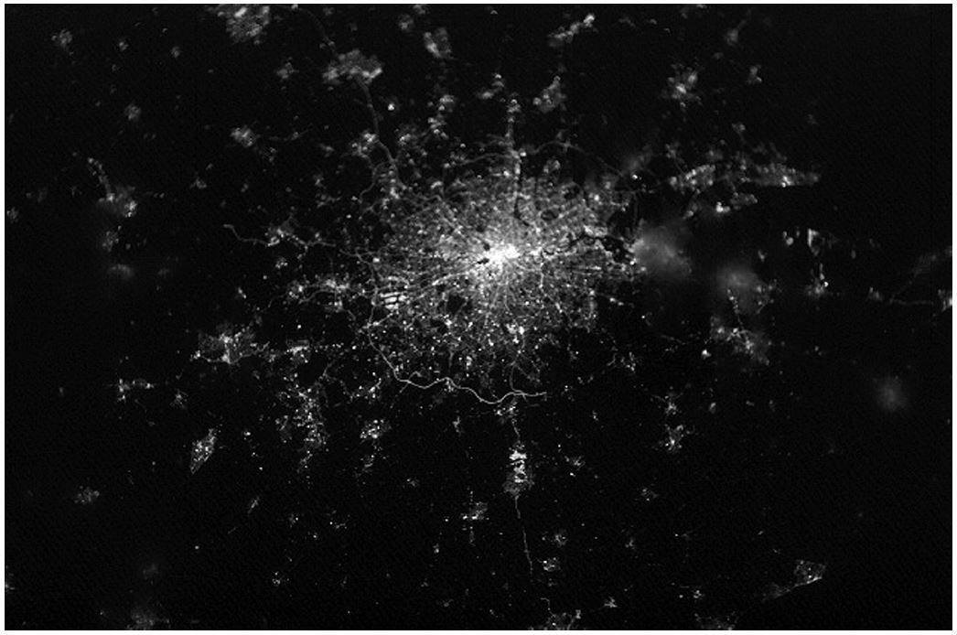
We Live in Communities
Looking down on London, England, at night from space. (Courtesy of NASA)

Slide 6
Living in Communities
Benefits
More secure against external dangers
Facilitate exchange of goods and services
Higher standard of living from economic specialization
Opportunities for fulfilling personal relationships
Costs
Certain actions are prohibited
Other actions are obligatory
Nonconformance can lead to punishment
Communities exist because benefits outweigh costs

Slide 7
The Ethical Point of View
Most everyone shares “core values”, desiring:
Life
Happiness
Ability to accomplish goals
Two ways to view world
Selfish point of view: consider only your own self and your core values
Ethical point of view: respect other people and their core values

Slide 8
Defining Terms
Society
Association of people organized under a system of rules
Rules: advance the good of members over time
Morality
A society’s rules of conduct
What people ought / ought not to do in various situations
Ethics
Rational examination of morality
Evaluation of people’s behavior

Slide 9
Why Study Ethics? (1 of 6)
“I changed as a person during this course because I can look at situations from different viewpoints now, viewpoints that I didn’t really have before taking this course.”
⎯ Quote from a student evaluation

Slide 10
Why Study Ethics? (2 of 6)
“I like to think that I do a good job of listening to someone else’s perspective but learning the ethical theories has allowed me to better understand the other person’s side and not just hear it.”
⎯ Quote from a student evaluation

Slide 11
Why Study Ethics? (3 of 6)
“I’ve changed as a person from this course by learning to look at issues more holistically. Ethical issues aren’t often obvious and take some deep diving to come to appropriate decisions.”
⎯ Quote from a student evaluation

Slide 12
Why Study Ethics? (4 of 6)
“It is apparent that most of what I have learned was information that I did not know that I did not know. In other words, it had never even occurred to me to ask the questions that were discussed in the course.”
⎯ Quote from a student evaluation

Slide 13
Why Study Ethics? (5 of 6)
“Despite having five years of college education, this is the first course that has made me stop and think, `Should I do this, even if I have the ability to?’”
⎯ Quote from a graduate student evaluation

Slide 14
Why Study Ethics? (6 of 6)
“Because of this course I have changed the way I approach my work. I co-own a data science startup called <name omitted> where we are developing analytics services that could potentially be misappropriated. Before this course my focus was simply on expanding the service to include as many features as possible. Now, I have instead a process with which to weigh the ethical ramifications of what we do.”
⎯ Quote from a graduate student evaluation

Slide 15
Introduction to Ethical Thinking
For each scenario
Everyone reads the scenario
Everyone reads the questions following the scenario
Each person reflects on their own responses to the questions
Students share their responses

Slide 16
Scenario 1 (1 of 2)
Alexis, a gifted high school student, wants to become a doctor. Because she comes from a poor family, she will need a scholarship in order to attend college. Some of her classes require students to do extra research projects in order to get an A. Her high school has a few older P Cs, but there are always long lines of students waiting to use them during the school day. After school, she usually works at a part-time job to help support her family.
One evening Alexis visits the library of a private college a few miles from her family's apartment, and she finds plenty of unused P Cs connected to the Internet. She surreptitiously looks over the shoulder of another student to learn a valid login/password combination. Alexis returns to the library several times a week, and by using its P Cs and printers she efficiently completes the extra research projects, graduates from high school with straight As, and gets a full-ride scholarship to attend a prestigious university.

Slide 17
Scenario 1 (2 of 2)
Was Alexis deceitful?
Did Alexis treat anyone unfairly?
Did Alexis violate anyone’s rights?
Who benefited from Alexis’s course of action and how great were the benefits?
Who was harmed by Alexis’s course of action of how great were the harms?
Would you call Alexis a good role model for other students?
Are there better ways Alexis could have accomplished her objective?
Did Alexis do the right thing?

Slide 18
Scenario 2 (1 of 2)
An organization dedicated to reducing spam tries to get Internet service providers (I S Ps) in an East Asian country to stop the spammers by protecting their email servers. When this effort is unsuccessful, the antispam organization puts the addresses of these I S Ps on its blacklist. Many I S Ps in the United States consult the blacklist and refuse to accept email from the blacklisted I S Ps. This action has two results. First, the amount of spam received by the typical email user in the United States drops by 25 percent. Second, tens of thousands of innocent computer users in the East Asian country are unable to send email to friends and business associates in the United States.

Slide 19
Scenario 2 (2 of 2)
Did the antispam organization do anything deceitful?
Was the organization unfair to anyone?
Did the organization violate anyone’s rights?
Who benefited from the organization’s action and how great were the benefits?
Who was harmed by the organization’s action and how great were the harms?
Could the organization have achieved its goals through a better course of action?
Did the organization do the right thing by creating the blacklist?

Slide 20
Scenario 3 (1 of 2)
To address the problem of accidents caused by speeding, the East Dakota State Legislature passes a law authorizing the East Dakota State Police (E D S P) to install video cameras on all of its freeway overpasses. The cameras are connected to computers that can reliably detect cars traveling more than five miles per hour above the speed limit. Sophisticated image recognition software enables the system to read license plate numbers and capture high-resolution pictures of vehicle drivers. If the picture of the driver matches the driver's license photo of one of the registered owners of the car, the system issues a speeding ticket to the driver, complete with photo evidence. The new system receives extensive media coverage, and six months after the system is put into operation, the number of people speeding on East Dakota freeways is reduced by 90 percent.
The F B I asks the E D S P for real-time access to the information collected by the video cameras. The E D S P complies with this request. Three months later, the F B I uses this information to arrest five members of a terrorist organization.

Slide 21
Scenario 3 (2 of 2)
Did the East Dakota State Police do anything deceitful?
Was the E D S P unfair to anyone?
Did the E D S P violate anyone’s rights?
Who benefited from the actions of the E D S P and how great were the benefits?
Who was harmed by the actions of the E D S P and how great were the harms?
What other courses of action could the E D S P have taken to achieve its objectives?
Did the E D S P do the right thing by complying with the request of the F B I?

Slide 22
Scenario 4 (1 of 3)
You are the senior software engineer at a start-up company developing an exciting new mobile app that will allow salespeople to generate and email sales quotes and customer invoices from their smartphones. You were given stock options when you joined the company, and if it has a successful initial public offering of stock, you will be able to sell these options for at least $10 million.
Your company's sales force has led a major corporation to believe your product will be available next week.

Slide 23
Scenario 4 (2 of 3)
Unfortunately, at this point the software still contains quite a few bugs. The leader of the testing group has reported that all of the known bugs appear to be minor, but it will take another month of testing for his team to be condent the product contains no catastrophic errors.
Because of the fierce competition in the mobile app industry, it is critical that your company be “first to market." To the best of your knowledge, a well-established company will release a similar product in a few weeks. If its product appears first, your start-up company will probably go out of business.

Slide 24
Scenario 4 (3 of 3)
Consider at least three possible actions, and for each of them, answer the following questions:
What are the most likely benefits and harms that will result from this action?
Do you have any obligations to people who may be negatively affected by your action?
Does this action require you to be dishonest, deceitful, or unfair to others?

Slide 25
More on Ethics
Ethics: rational, systematic analysis
Conclusions must be supported
Best explanations based on facts, shared values, logic
Ethics focuses on people’s voluntary, moral choices
Workable ethical theory: produces explanations that might be persuasive to a skeptical, yet open-minded audience

Slide 26
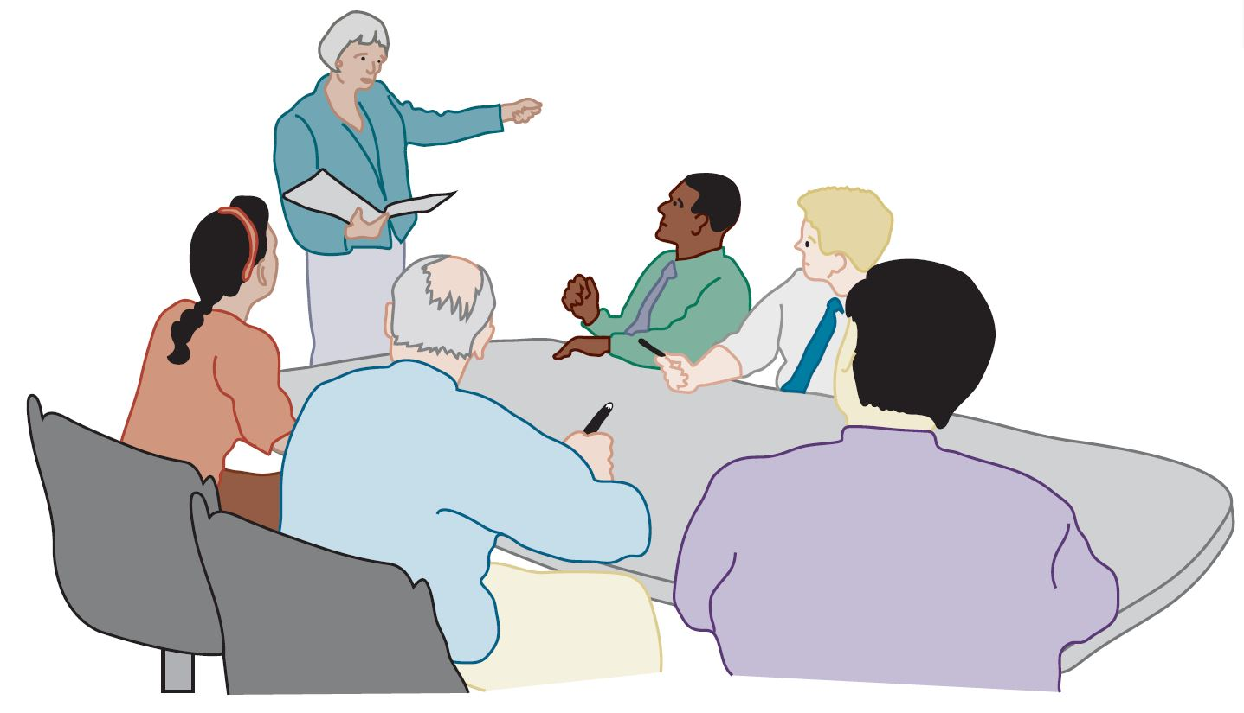
A Good Ethical Theory Enables You to Make Persuasive, Logical Arguments

Slide 27
2.2 Subjective Relativism

Slide 28
Relativism and Subjective Relativism
Ethical relativism
No universal standards of right and wrong
One person can say “X is right,” another can say “X is wrong,” and both can be correct
Subjective relativism
Each person decides right and wrong for himself or herself
“What’s right for you may not be right for me”

Slide 29
Case for Subjective Relativism
Well-meaning and intelligent people disagree on moral issues
Ethical debates are disagreeable and pointless

Slide 30
Case Against Subjective Relativism
Blurs line between doing what you think is right and doing what you feel like doing
Makes no moral distinction between the actions of different people
Subjective relativism and tolerance are two different things
Decisions may not be based on reason
Conclusion: Not a workable ethical theory

Slide 31
2.3 Cultural Relativism

Slide 32
Cultural Relativism in a Nutshell
What is “right” and “wrong” depends upon a society’s actual moral guidelines
These guidelines vary from place to place and from time to time
A particular action may be right in one society at one time and wrong in another society or at another time

Slide 33
Case for Cultural Relativism
Different social contexts demand different moral guidelines
It is arrogant for one society to judge another

Slide 34
Case Against Cultural Relativism (1 of 2)
Because two societies do have different moral views doesn’t mean they ought to have different views
It doesn’t explain how moral guidelines are determined
What if there are no cultural norms?
It doesn’t account for evolution of moral guidelines.
It provides no way out for cultures in conflict

Slide 35
Case Against Cultural Relativism (2 of 2)
Existence of many acceptable practices does not imply all practices are acceptable (many/any fallacy)
Societies do, in fact, share certain core values
Only indirectly based on reason
Conclusion: Not a workable ethical theory

Slide 36
2.4 Divine Command Theory

Slide 37
Overview of Divine Command Theory
Good actions: those aligned with God’s will
Bad actions: those contrary to God’s will
Holy books reveal God’s will
We should use holy books as moral decision-making guides

Slide 38
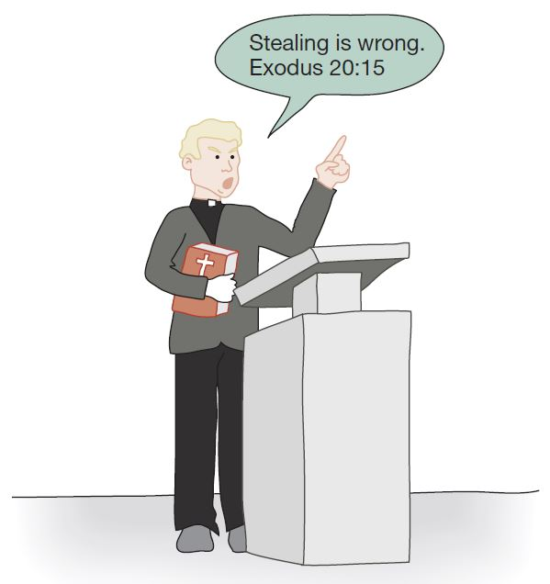
Divine Command Theory in Action

Slide 39
Case for Divine Command Theory
We owe obedience to our Creator
God is all-good and all-knowing
God is the ultimate authority

Slide 40
Case Against Divine Command Theory
Different holy books disagree on certain teachings
Divine command theory is impractical because society is multicultural, secular
Some modern moral problems not directly addressed in scripture
Based on obedience, not reason
Conclusion: Not a workable ethical theory for our purposes

Slide 41
2.5 Ethical Egoism

Slide 42
Definition of Ethical Egoism
Each person should focus exclusively on his or her self-interest
Morally right action: that action that provides self with maximum long-term benefit
Ayn Rand, author of The Fountainhead and Atlas Shrugged, espoused a theory akin to ethical egoism, but this section is not a summary of her theory

Slide 43
Case for Ethical Egoism
It is practical since we are already inclined to do what’s best for ourselves
It is better to let other people take care of themselves
The community can benefit when individuals put their well-being first
Other moral principles are rooted in the principle of self-interest

Slide 44
Case Against Ethical Egoism (1 of 2)
An easy moral philosophy may not be the best moral philosophy
We know a lot about what is good for someone else
Self-interest can lead to blatantly immoral behavior
Other moral principles are superior to principle of self-interest

Slide 45
Case Against Ethical Egoism (2 of 2)
People who take the good of others into account lead happier lives
By definition, does not respect the ethical point of view
Conclusion: Not a workable ethical theory

Slide 46
2.6 Kantianism

Slide 47
Critical Importance of Good Will
Good will: the desire to do the right thing
Immanuel Kant: Only thing in the world that is good without qualification is a good will
Reason should cultivate desire to do right thing

Slide 48
Categorical Imperative (1st Formulation)
Act only from moral rules that you can at the same time will to be universal moral laws.

Slide 49
Illustration of 1st Formulation (1 of 2)
Question: Can a person in dire straits make a promise with the intention of breaking it later?
Proposed rule: “I may make promises with the intention of later breaking them.”
The person in trouble wants his promise to be believed so he can get what he needs.

Slide 50
Illustration of 1st Formulation (2 of 2)
Universalize rule: Everyone may make & break promises
Everyone breaking promises would make promises unbelievable, contradicting desire to have promise believed
The rule is flawed. The answer to the question is “No.”

Slide 51
Another Way to Reason It out (1 of 2)
Question: Can I make a promise with the intention of breaking it later?
I want my false promise to be believed.
In order for my false promised to be believable, I want everyone except myself to be truthful all the time.

Slide 52
Another Way to Reason It out (2 of 2)
In other words, I want to privilege my needs and desires over those of everyone else.
Contradiction between what I want to do and what I want others to do.
Therefore, what I am considering doing is wrong.

Slide 53
A Quick Check
When evaluating a proposed action, reverse roles
What would you think if that person did the same thing to you?
Negative reaction → evidence that your will to do that action violates the Categorical Imperative

Slide 54
Categorical Imperative (2nd Formulation)
Act so that you treat both yourself and other people as ends in themselves and never only as a means to an end.
This is usually an easier formulation to work with than the first formulation of the Categorical Imperative.

Slide 55
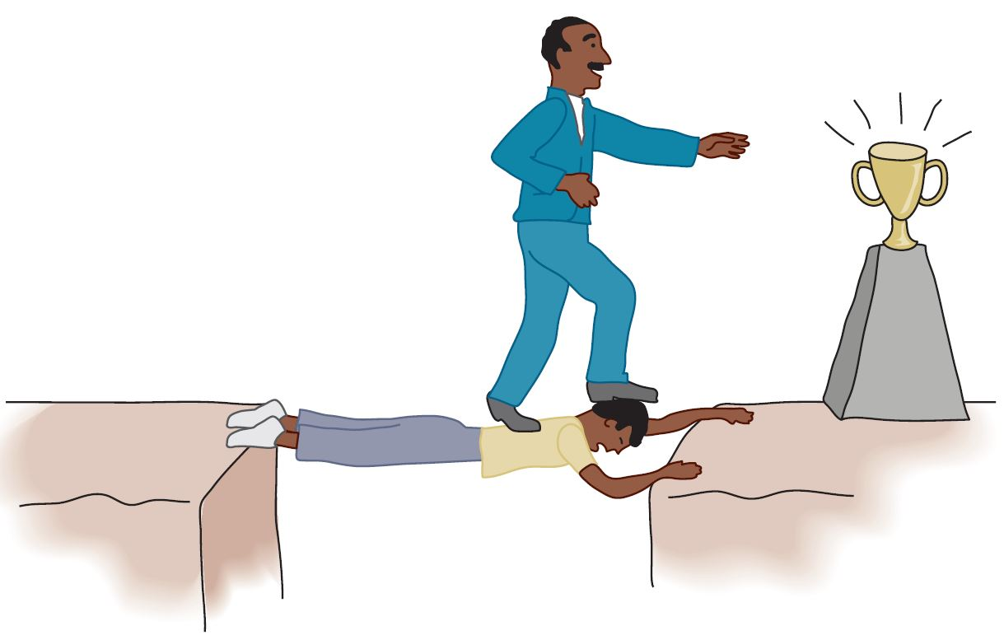
Kant: Wrong to Use Another Person Solely as a Means to an End

Slide 56
Plagiarism Scenario
Carla
Single mother
Works full time
Takes two evening courses/semester
History class
Requires more work than normal
Carla earning an “A” on all work so far
Carla doesn’t have time to write final report
Carla purchases report; submits it as her own work

Slide 57
Kantian Evaluation (1st Formulation)
Carla wants credit for plagiarized report
Rule: “You may claim credit for work performed by someone else”
If rule universalized, reports would no longer be credible indicator’s of student’s knowledge, and professors would not give credit for reports
Proposal moral rule is self-defeating
It is wrong for Carla to turn in a purchased report

Slide 58
Kantian Evaluation (2nd Formulation)
Carla submitted another person’s work as her own
She attempted to deceive professor
She treated professor as a means to an end
End: passing the course
Means: manipulate professor
What Carla did was wrong

Slide 59
Case for Kantianism
Treats all persons as moral equals
Gives all people moral worth as rational, autonomous beings
Holds everyone to the same standard
Produces universal moral guidelines

Slide 60
Perfect and Imperfect Duties
Perfect duty: duty obliged to fulfill without exception
Example: Telling the truth
Imperfect duty: duty obliged to fulfill in general but not in every instance
Example: Helping others

Slide 61
Case Against Kantianism
Sometimes no rule adequately characterizes an action
Sometimes there is no way to resolve a conflict between rules
In a conflict between a perfect duty and an imperfect duty, perfect duty prevails
In a conflict between two perfect duties, no solution
Kantianism allows no exceptions to perfect duties
Conclusion: Despite weaknesses, a workable ethical theory

Slide 62
2.7 Act Utilitarianism

Slide 63
Principle of Utility (1 of 2)
Jeremy Bentham and John Stuart Mill
An action is good if its benefits exceeds its harms
An action is bad if its harms exceed its benefits
Utility: tendency of an object to produce happiness or prevent unhappiness for an individual or a community
Happiness = advantage = benefit = good = pleasure
Unhappiness = disadvantage = cost = evil = pain

Slide 64
Principle of Utility (Greatest Happiness Principle)
An action is right (or wrong) to the extent that it increases (or decreases) the total happiness of the affected parties.

Slide 65
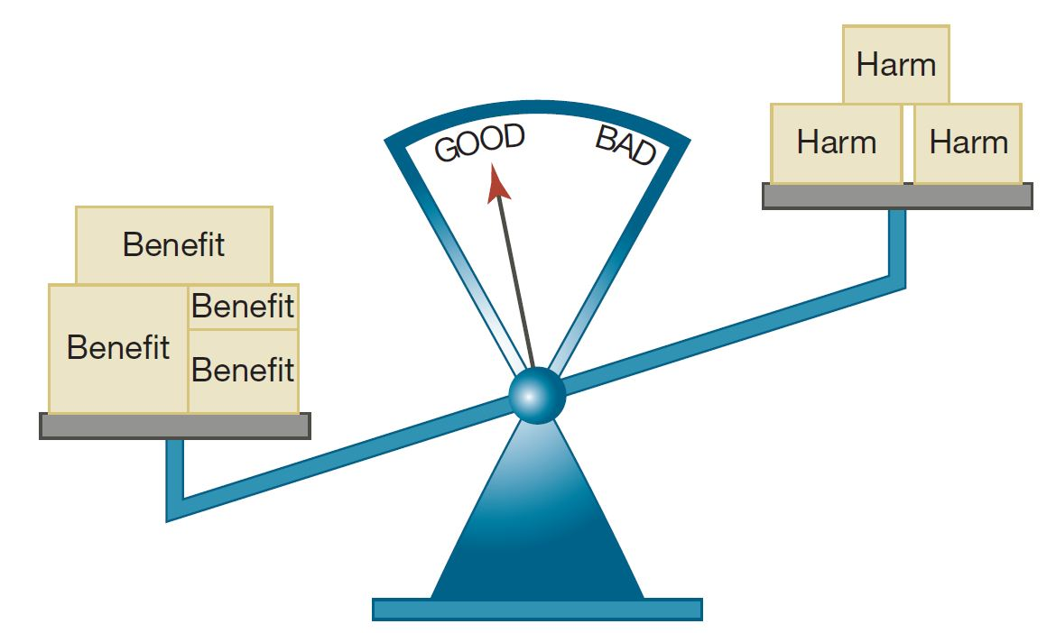
Principle of Utility (2 of 2)

Slide 66
Act Utilitarianism
Utilitarianism
Morality of an action has nothing to do with intent
Focuses on the consequences
A consequentialist theory
Act utilitarianism
Add up change in happiness of all affected beings
Sum > 0, action is good
Sum < 0, action is bad
Right action to take: one that maximizes the sum

Slide 67
Bentham: Weighing Pleasure/Pain
Intensity
Duration
Certainty
Propinquity
Fecundity
Purity
Extent

Slide 68
Highway Routing Scenario
State may replace a curvy stretch of highway
New highway segment 1 mile shorter
150 houses would have to be removed
Some wildlife habitat would be destroyed

Slide 69
Evaluation
Costs
$20 million to compensate homeowners
$10 million to construct new highway
Lost wildlife habitat worth $1 million
Benefits
$39 million savings in automobile driving costs
Conclusion
Benefits exceed costs
Building highway a good action

Slide 70
Case for Act Utilitarianism
Focuses on happiness
Down-to-earth (practical)
Comprehensive

Slide 71
Case Against Act Utilitarianism
Unclear whom to include in calculations and how far out into the future to consider
Too much work
Ignores our innate sense of duty
We cannot predict consequences with certainty
Susceptible to the problem of moral luck
Conclusion: Overall, a workable ethical theory

Slide 72
2.8 Rule Utilitarianism

Slide 73
Applying Principle of Utility to Rules
We ought to adopt moral rules which, if followed by everyone, will lead to the greatest increase in total happiness
Act utilitarianism applies Principle of Utility to individual actions
Rule utilitarianism applies Principle of Utility to moral rules

Slide 74
Anti-Worm Scenario
August 2003: Blaster worm infected thousands of Windows computers
Soon after, Nachi worm appeared
Took control of vulnerable computer
Located and destroyed copies of Blaster
Downloaded software patch to fix security problem
Used computer as launching pad to try to “infect” other vulnerable P Cs

Slide 75
Evaluation Using Rule Utilitarianism (1 of 2)
Proposed rule: If I can write a helpful worm that removes a harmful worm from infected computers and shields them from future attacks, I should do so
Who would benefit
People who do not keep their systems updated

Slide 76
Evaluation Using Rule Utilitarianism (2 of 2)
Who would be harmed
People who use networks
People who’s computers are invaded by buggy anti-worms
System administrators
Conclusion: Harm outweighs benefits. Releasing anti-worm is wrong.

Slide 77
Case for Rule Utilitarianism
Not every moral decision requires performing utilitarian calculus
Moral rules survive exceptional situations
Avoids the problem of moral luck
Reduces the problem of bias
Appeals to a wide cross-section of society

Slide 78
Case Against Utilitarianism in General
All consequences must be measured on a single scale.
All units must be the same in order to do the sum
In certain circumstances utilitarians must quantify the value of a human life
Utilitarianism ignores the problem of an unjust distribution of good consequences.
Utilitarianism does not mean “the greatest good of the greatest number” That requires a principle of justice
What happens when a conflict arises between the Principle of Utility and a principle of justice?
Conclusion: Despite weaknesses, both act utilitarianism and rule utilitarianism are workable ethical theories

Slide 79
2.9 Social Contract Theory

Slide 80
Basis of Social Contract Theory
Thomas Hobbes
In a “state of nature” our lives would be “solitary, poore, nasty, brutish, and short”
We implicitly accept a social contract
Establishment of moral rules to govern relations among citizens
Government capable of enforcing these rules
Jean-Jacques Rousseau
In ideal society, no one above rules
That prevents society from enacting bad rules

Slide 81
James Rachels’s Definition
“Morality consists in the set of rules, governing how people are to treat one another, that rational people will agree to accept, for their mutual benefit, on the condition that others follow those rules as well.”

Slide 82
Kinds of Rights
Negative right: A right that another can guarantee by leaving you alone
Positive right: A right obligating others to do something on your behalf
Absolute right: A right guaranteed without exception
Limited right: A right that may be restricted based on the circumstances

Slide 83
Correlation between Types of Rights
Positive rights tend to be more limited
Negative rights tends to be more absolute

Slide 84
John Rawls’s Principles of Justice
Each person may claim a “fully adequate” number of basic rights and liberties, so long as these claims are consistent with everyone else having a claim to the same rights and liberties
Any social and economic inequalities must
Be associated with positions that everyone has a fair and equal opportunity to achieve
Be to the greatest benefit of the least-advantaged members of society (the difference principle)

Slide 85
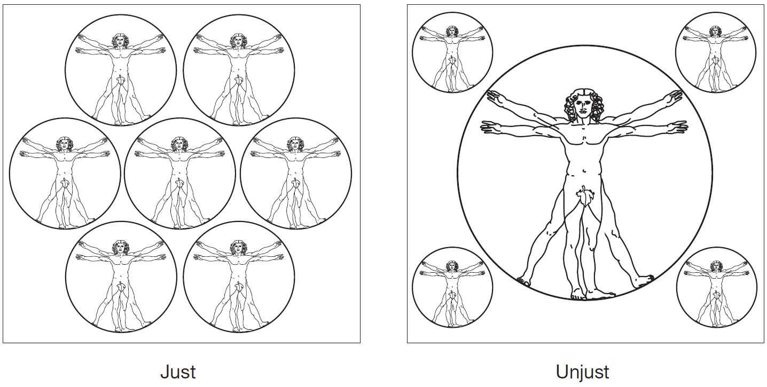
Rawls’s First Principle of Justice
Rawls’s first principle of justice states that each person may have a “fully adequate” number of rights and liberties as long as they are consistent with everyone else having the same rights and liberties.

Slide 86
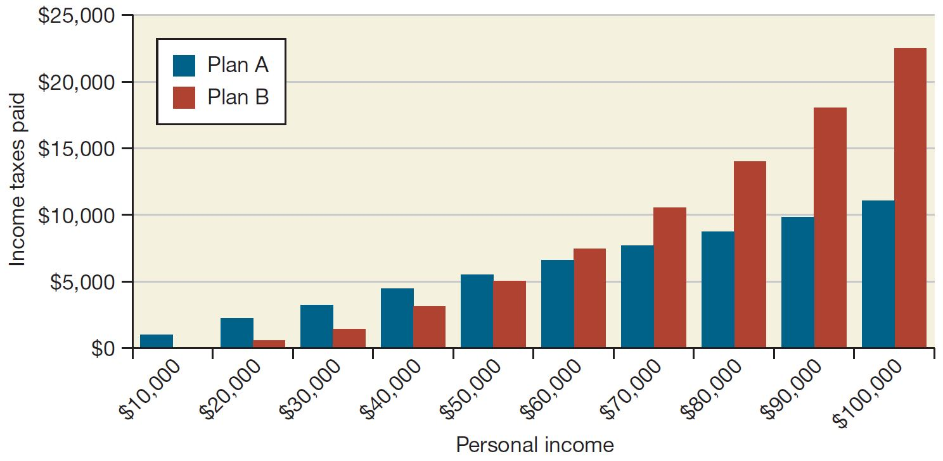
Rawls’s Difference Principle
Plan B (progressive income tax) does not treat every citizen equally, but it the inequality is justified under Rawls’s difference principle because it is of the greatest benefit to the most disadvantaged.

Slide 87
Convenience Stores Scenario
Bill owns chain of convenience stores
Collects information about purchases from customers
Constructs profiles of customers
Who owns a pet, who cares for an infant, etc.
Sells profiles to direct marketing firms
Some customers happy to receive more mail order catalogs; others unhappy at increase in “junk mail”

Slide 88
Evaluation (Social Contract Theory) (1 of 2)
Consider rights of Bill, customers, and mail order companies.
Does customer have right to expect name, address to be kept confidential?
If customer purchases something from Bill, who owns information about transaction?

Slide 89
Evaluation (Social Contract Theory) (2 of 2)
If Bill and customer have equal rights to information, Bill did nothing wrong to sell information.
If customers have right to expect name and address or transaction to be confidential without giving permission, then Bill was wrong to sell information without asking for permission.

Slide 90
Case for Social Contract Theory
Framed in language of rights
Explains why people act in self-interest in absence of common agreement
Tragedy of the commons
Provides clear analysis of certain citizen/government problems
Why okay for government to deprive criminals of certain rights
Why civil obedience can be morally right action

Slide 91
Case Against Social Contract Theory
No one signed social contract
Some actions have multiple characterizations
Conflicting rights problem
May unjustly treat people incapable of upholding contract
Conclusion: Despite weaknesses, a workable theory

Slide 92
2.10 Virtue Ethics

Slide 93
Critique of Enlightenment Theories
Kantianism, utilitarianism, social contract theory ignore important moral considerations
moral education
moral wisdom
family and social relationships
role of emotions
Virtue ethics
arete, virtue, excellence: reaching highest potential
Aristotle’s Nicomachean Ethics (4th century B C)

Slide 94
Virtues and Vices
Two types of virtue
intellectual virtues: virtues associated with reasoning and truth
moral virtues: virtues of character (e.g., honesty)
Moral virtues
developed by habitually performing right action
deep-seated character traits
disposition to act in a certain way and feel in a certain way

Slide 95
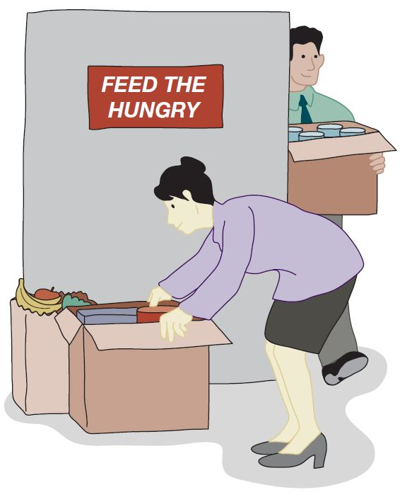
Aristotle on Happiness
According to Aristotle, happiness derives from living a life of virtue. You acquire moral virtues by repeating the appropriate acts.

Slide 96
Summary of Virtue Ethics
A right action is an action that a virtuous person, acting in character, would do in the same circumstances.
A virtuous person is a person who possesses and lives out the virtues.
The virtues are those character traits human beings needs in order to flourish and be truly happy.

Slide 97
Vices
Vices are opposite of virtues
Vice: a character trait that prevents a human being from flourishing or being truly happy
Often, a virtue situated between two vices
Courage between cowardliness and rashness
Generosity between stinginess and prodigality

Slide 98
Case for Virtue Ethics
It often makes more sense to focus on virtues than obligations, rights, or consequences
Personal relationships can be morally relevant to decision making
Theory recognizes our moral decision-making skills develop over time
With this theory there are no irresolvable moral dilemmas
Emotions play an important role in living a moral life

Slide 99
Case Against Virtue Ethics
Reasonable people may disagree on character traits needed for human flourishing
Cannot use virtue ethics to guide government policy
Virtue ethics undermines attempts to hold people responsible for their bad actions
Conclusion: Despite weaknesses, virtue ethics a workable theory

Slide 100
2.11 Comparing Workable Ethical Theories

Slide 101
Ethical Objectivism versus Relativism
Ethical objectivism: Morality has an existence outside the human mind
Relativism: Morality is a human invention
Divine command theory, ethical egoism, Kantianism, utilitarianism, social contract theory, and virtue ethics examples of ethical objectivism

Slide 102
Workable Ethical Theories
We seek theories with these characteristics:
Based on the ethical point of view
Objective moral principles developed using logical reasoning based on facts and commonly held values
Workable ethical theories
Kantianism
Act and rule utilitarianism
Social contract theory
Virtue ethics

Slide 103
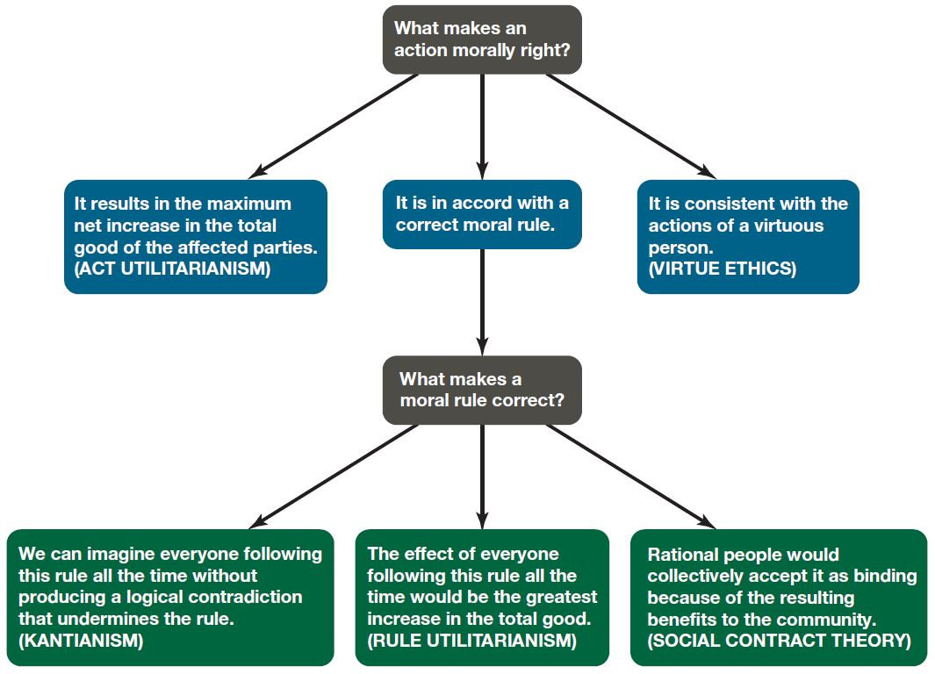
Comparing Workable Ethical Theories

Slide 104
2.12 Morality of Breaking the Law

Slide 105
Social Contract Theory Perspective
Everyone in society bears certain burdens in order to receive certain benefits
Legal system supposed to guarantee people’s rights are protected
Everything else being equal, we should be law-abiding
Should only break law if compelled to follow a higher-order moral obligation

Slide 106
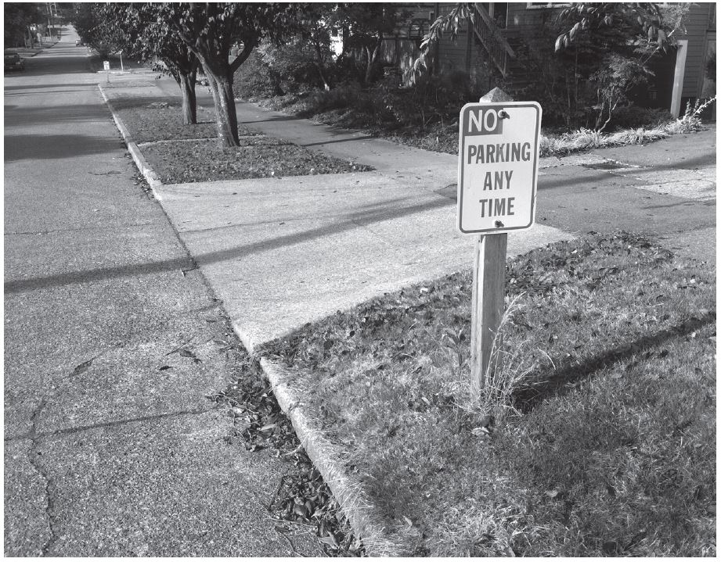
Law and Social Contract Theory
According to social contract theory, we have a prima facie obligation to obey the law.

Slide 107
Kantian Perspective
Everyone wants to be treated justly
Imagine rule: “I may break a law I believe to be unjust”
If everyone acted according to this rule, then laws would be subverted
Contradiction: Cannot both wish to be treated justly and allow laws to be subverted

Slide 108
Rule Utilitarian Perspective
What would be consequences of people ignoring laws they felt to be unjust?
Beneficial consequence: Happiness of people who are doing what they please
Harmful consequences: Harm to people directly affected by lawless actions, general loss of respect for laws, increased burden on criminal justice system
Harms greater than benefits

Slide 109
Act Utilitarian Perspective
Possible to conceive of situations where benefits of breaking law exceed harms
Suppose give penniless, bedridden friend copy of C D
Friend benefits by $15 (value of C D)
I benefit by $10 (satisfaction of helping friend)
Harms of $0 (no lost sale, no police involvement)
With $25 of benefit and $0 of harm, action is determined to be good

Slide 110
Summary

Slide 111
Insights Offered by Various Theories (1 of 2)
Kantianism: Every person is equally valuable, and when you interact with other people you should always respect them as rational beings. It is wrong to privilege your needs and desires over those of other people.
Utilitarianism: You should consider the consequences of an action before deciding whether it’s right or wrong.

Slide 112
Insights Offered by Various Theories (2 of 2)
Social contract theory: We should collectively promote human rights, such as the rights to life, liberty, and property.
Virtue ethics: You can count on a good person to do the right thing at the right time in the right way.

Slide 113
It’s up to You
You can consider duties and rights and consequences and virtues when making moral decisions
Ultimately, you have to decide:
What kind of person do I want to be?
What kind of world do I want to live in?

Slide 114

Copyright
This work is protected by United States copyright laws and is provided solely for the use of instructors in teaching their courses and assessing student learning. Dissemination or sale of any part of this work (including on the World Wide Web) will destroy the integrity of the work and is not permitted. The work and materials from it should never be made available to students except by instructors using the accompanying text in their classes. All recipients of this work are expected to abide by these restrictions and to honor the intended pedagogical purposes and the needs of other instructors who rely on these materials.

